Slide 1
Representing Vector Fields on a 2-Sphere Using Vector Spherical Harmonics
Frank Corapi

Slide 2
Introduction
For black holes with no symmetries, there is no unique definition of angular momentum¹
This work will build off of Korzynski’s definition of angular momentum for a conformally spherical surface
Numerical implementation of representing scalar and vector functions as scalar or vector spherical harmonic series on a round 2-sphere
This is the initial step of a larger project, where properties of a black hole horizon will be found by evolving a black hole spacetime metric using Ricci flow^{1,2}
M. Korzynski, “Quasi-local angular momentum of nonsymmetric isolated and dynamical horizons from the conformal decomposition of the metric,” Classical and Quantum Gravity, vol. 24, no. 23, pp. 5935–5943, 2007.
R. S. Hamilton, “The ricci flow on surfaces,” Mathematics and General Relativity Contemporary Mathematics, pp. 237–262, 1988.

Slide 3
Spherical Harmonics Definitions

Slide 4


Scalar Spherical Harmonics
Scalar spherical harmonics are defined as¹
They are eigenfunctions of the Laplace operator in spherical coordinates and satisfy the following relationship¹
1) “Wolfram mathworld: Spherical harmonic.” http://mathworld.wolfram.com/SphericalHarmonic.html. Accessed: 2018-08-15.

Slide 5



Scalar Spherical Harmonics
The orthogonality of the scalar spherical harmonics is given by the scalar product¹
This orthogonality allows scalar functions to be represented as a series of scalar spherical harmonics²
The coefficients of the series can be determined by implementing the orthogonality relationship
1) E. Berti, Black Hole Perturbation Theory. International Center for Theoretical Sciences Summer School on Gravitational-Wave Astronomy, 2016.
2) M. J. Mohlenkamp, A Users Guide to Spherical Harmonics. 2016.

Slide 6
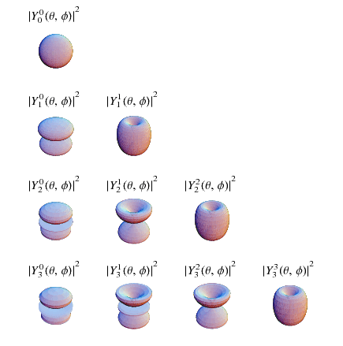
Scalar Spherical Harmonics
1
1) “Wolfram mathworld: Spherical harmonic.” http://mathworld.wolfram.com/SphericalHarmonic.html. Accessed: 2018-08-15.

Slide 7





Vector Spherical Harmonics
Polar Vector Spherical Harmonics:¹
Axial Vector Spherical Harmonics:¹
Last equalities are their representation in the spherical coordinate basis, with the following 2-metric and Levi-Civita tensor¹
1) E. Berti, Black Hole Perturbation Theory. International Center for Theoretical Sciences Summer School on Gravitational-Wave Astronomy, 2016.

Slide 8


Vector Spherical Harmonics
The scalar product for vectors is given by¹
The vector spherical harmonics also have an orthogonality relationship¹
1) E. Berti, Black Hole Perturbation Theory. International Center for Theoretical Sciences Summer School on Gravitational-Wave Astronomy, 2016.

Slide 9




Vector Spherical Harmonics
Vector fields can be represented as a series of polar or axial vector spherical harmonics¹
Similar to the scalar spherical harmonics, applying the orthogonality relation gives the coefficients of the series¹
Polar Vector Series
Axial Vector Series
1) M. J. Mohlenkamp, A Users Guide to Spherical Harmonics. 2016.

Slide 10
Surface Properties

Slide 11

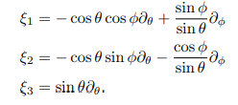

Conformally Spherical Metric
A conformally spherical metric is given by:^{1,2}
The choice of the conformal factor defines a specific conformally spherical coordinate system¹
These coordinate systems are related by conformal transformations of the spherical metric¹
The action of these transformations on a surface are generated by six vector fields¹
1) M. Korzynski, “Quasi-local angular momentum of nonsymmetric isolated and dynamical horizons from the conformal decomposition of the metric,” Classical and Quantum Gravity, vol. 24, no. 23, pp. 5935–5943, 2007.
2) G. B. Cook, “Initial data for numerical relativity,” Living Reviews in Relativity, vol. 3, no. 1, 2000.

Slide 12
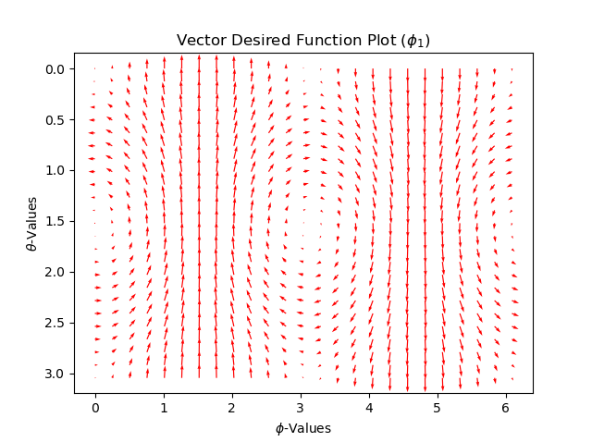
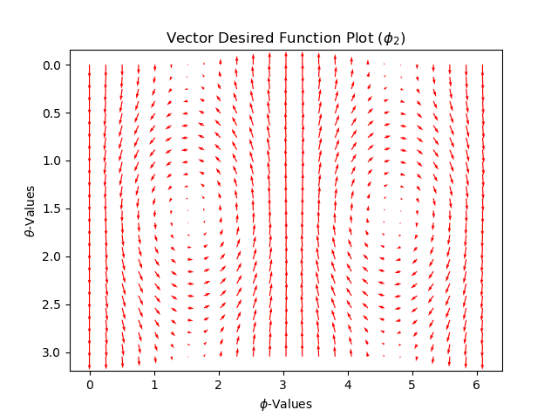
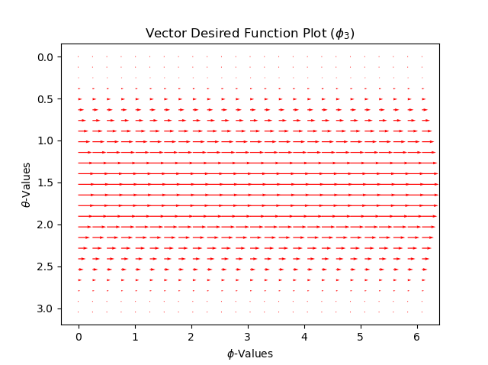
ϕ-Fields

Slide 13
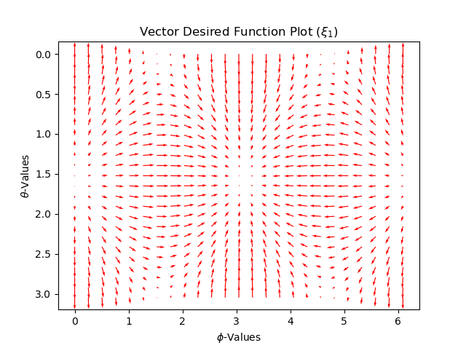
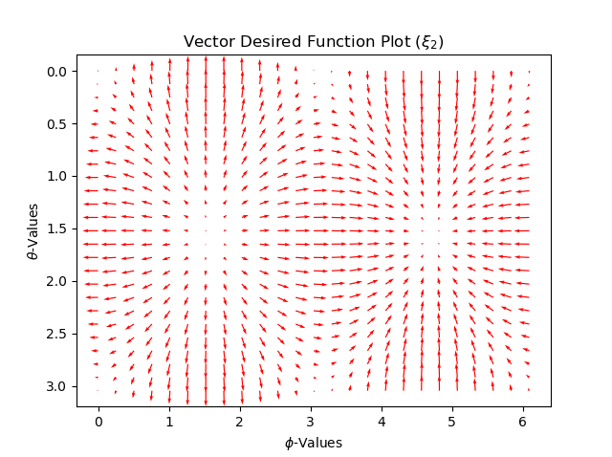
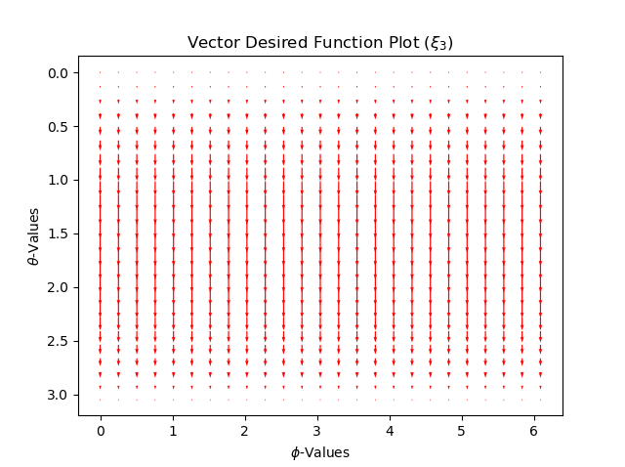
ξ-Fields

Slide 14





Angular Momentum¹
The angular momentum of a conformally spherical surface can be determined through the evaluation of six integrals
where
Two invariants:
Angular Momentum:
1) M. Korzynski, “Quasi-local angular momentum of nonsymmetric isolated and dynamical horizons from the conformal decomposition of the metric,” Classical and Quantum Gravity, vol. 24, no. 23, pp. 5935–5943, 2007.

Slide 15





Other Properties
Area:¹
Areal Radius:¹
Irreducible Mass:¹
Mass Energy:^{1,2}
Spin:^{1,2}
1) R. M. Wald, General relativity. The University of Chicago Press, 1984.
2) D. Christodoulou, “Reversible and irreversible transformations in black-hole physics,” Physical Review Letters, vol. 25, no. 22, pp. 1596–1597, 1970.

Slide 16
Numerical Implementation

Slide 17
Numerical Implementation (Python)
Gauss-Legendre quadrature was used for integration along the z-axis¹
Evenly spaced integration points were used for integration along the φ-direction¹
A finite difference method (ε=10⁻⁵) was used to calculate the derivatives of the scalar spherical harmonics
Scalar and vector fields were represented in terms of scalar and vector spherical harmonics on a round 2-sphere
Poisson’s equation was solved using a spherical harmonics series method
Angular momentum of a round 2-sphere and other properties were calculated for different test cases for ω_{A}
1) C. H. L. Beentjes, Quadrature on a Spherical Surface. Mathematical Institute, University of Oxford, Oxford, UK, 2015.

Slide 18
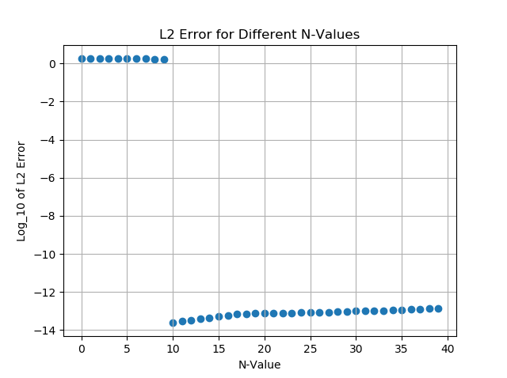
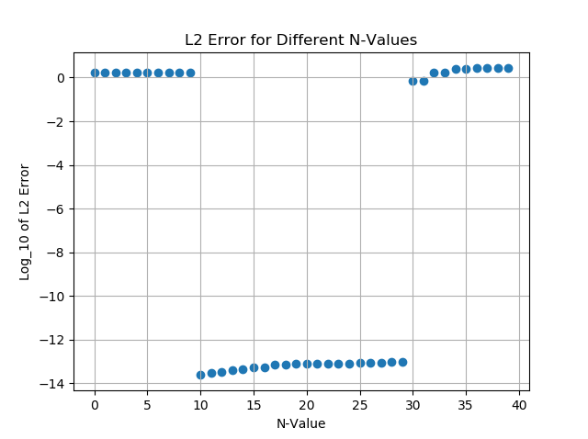
Numerical Implementation – Scalar Functions
60 φ-points
30 φ-points
f(θ, φ) = sin(10θ)cos(φ)

Slide 19
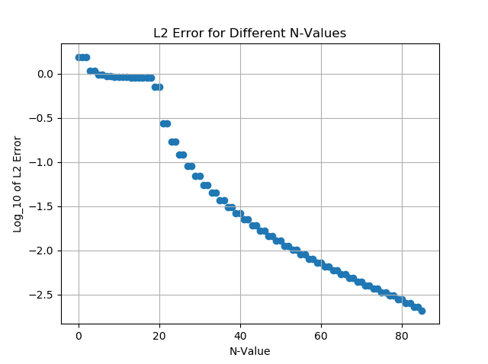
Numerical Implementation – Scalar Functions
f(θ, φ) = sin²(10θ)cos(3φ)

Slide 20


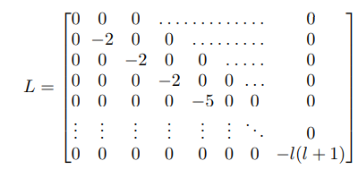
Numerical Implementation – Poisson’s Equation
The Laplacian of a function:
First, the series coefficients for a given function, ρ, are found and then the coefficients for Φ are found by solving this system of linear equations
where

Slide 21
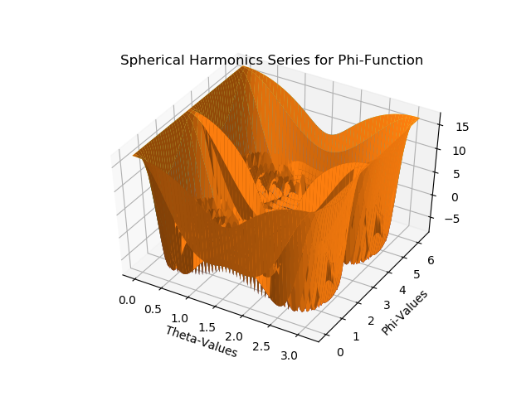
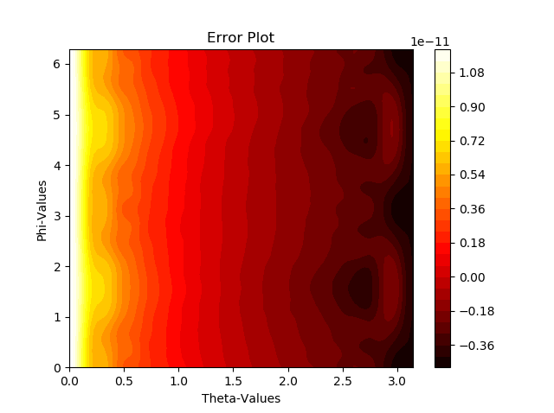
Numerical Implementation – Poisson’s Equation
Φ function given by a linear combination of all the scalar spherical harmonics ranging from l = 0 to l = 24, with every other m-value for each l term, ranging from −l to l

Slide 22
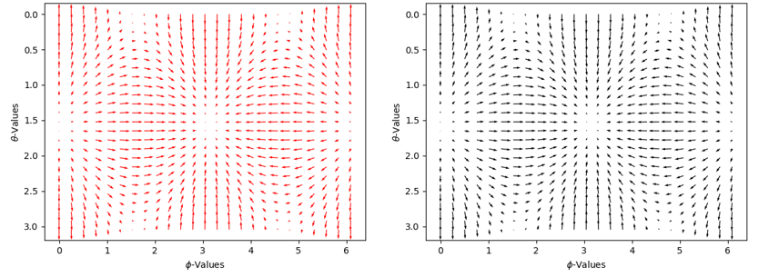
Numerical Implementation – Polar Vector Fields
The field ξ_{1A}
The analytic solution is in red
Vector spherical harmonic series solution is in black
L2 Error = 5.45 × 10⁻¹¹

Slide 23
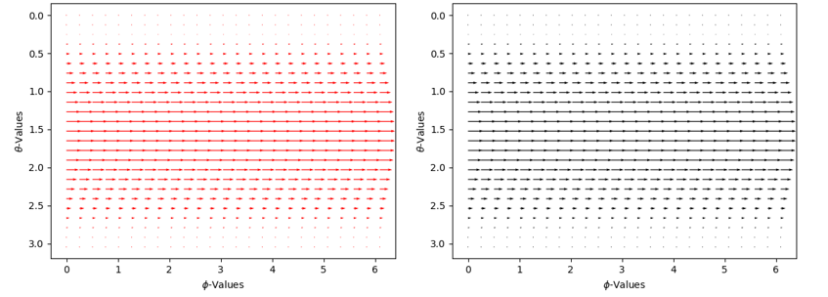
Numerical Implementation – Axial Vector Fields
The field ϕ_{3A}
The analytic solution is in red
Vector spherical harmonic series solution is in black
L2 Error = 3.09 × 10⁻¹¹

Slide 24
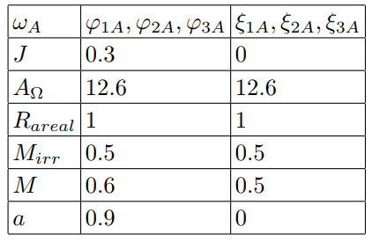
Numerical Implementation – Other Properties
Numerically calculated surface (round 2-sphere) properties for six different test cases for ω_{A}

Slide 25
Discussion and Future Steps
Functions that were explicitly a linear combination of the spherical harmonics converged to a low error
Finding both the axial and polar coefficients for vector fields will be implemented
Finding properties of a conformally spherical surface must be implemented
Use different ω_{A} test cases, where ω_{A} is found from a black hole spacetime metric
Use Ricci flow¹ to modify a conformally spherical metric from a numerical simulation in order to determine the angular momentum of the horizon of a simulated black hole
1) R. S. Hamilton, “The ricci flow on surfaces,” Mathematics and General Relativity Contemporary Mathematics, pp. 237–262, 1988.

Slide 26
Thank you

Slide 27
References
“Wolfram mathworld: Spherical harmonic.” http:// mathworld.wolfram.com/SphericalHarmonic.html. Accessed: 2018-08-15.
E. Berti, Black Hole Perturbation Theory. International Center for Theoretical Sciences Summer School on Gravitational-Wave Astronomy, 2016.
M. J. Mohlenkamp, A Users Guide to Spherical Harmonics. 2016.
G. B. Cook, “Initial data for numerical relativity,” Living Reviews in Relativity, vol. 3, no. 1, 2000.
M. Korzynski, “Quasi-local angular momentum of nonsymmetric isolated and dynamical horizons from the conformal decomposition of the metric,” Classical and Quantum Gravity, vol. 24, no. 23, pp. 5935–5943, 2007.
R. S. Hamilton, “The ricci flow on surfaces,” Mathematics and General Relativity Contemporary Mathematics, pp. 237–262, 1988.
R. M. Wald, General relativity. The University of Chicago Press, 1984.
D. Christodoulou, “Reversible and irreversible transformations in black-hole physics,” Physical Review Letters, vol. 25, no. 22, pp. 1596–1597, 1970.
C. H. L. Beentjes, Quadrature on a Spherical Surface. Mathematical Institute, University of Oxford, Oxford, UK, 2015.

Slide 28
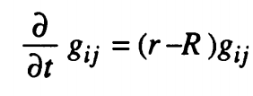

Ricci Flow¹
Ricci flow equation:
where
is the mean scalar curvature.
1) R. S. Hamilton, “The ricci flow on surfaces,” Mathematics and General Relativity Contemporary Mathematics, pp. 237–262, 1988.

